Slide 1
Residual-Guide Network for Single Image Deraining
Zhiwen Fan，Huafeng Wu，Xueyang Fu，
Yue Huang，Xinghao Ding
School of Information Science and
Engineering, Xiamen University, China.
Notes:
第一页

Slide 2
Abstract
In this paper, we propose a novel residual-guide feature fusion network, called ResGuideNet。
we propose a cascaded network and adopt residuals generated from shallower blocks to guide deeper blocks。
The outputs of different blocks are merged into the final reconstruction.
We adopt recursive convolution to build each block and apply supervision to all intermediate results.
Notes:
第二页

Slide 3
Introduction
Q:per-pixel losses do not close to perceptual difference between output and ground-truth images 。
it is wasteful to utilize a resource-hungry model to meet all kinds of demands for rain streak removal tasks。
A：Each block contains a global shortcut to predict residua。
We then proposed to concatenate the predicted residuals from shallower to the deeper blocks。appling supervision to all intermediate outputs which can obtain a coarse-to-fine residual as the blocks go deeper。
The final recovered image merges all outputs of intermediate reconstruction。

Slide 4
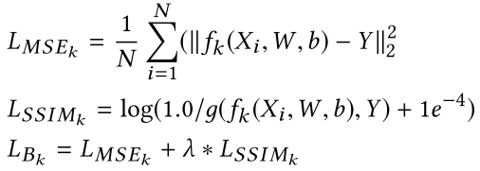

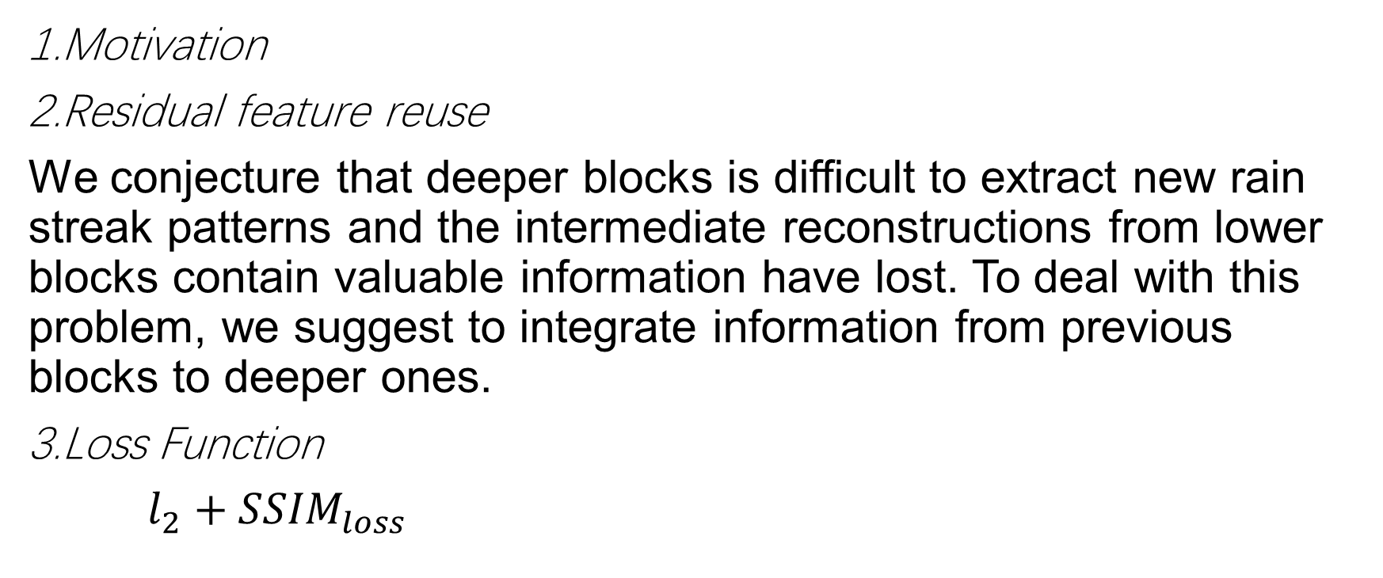
METHOD
1.Motivation
2.Residual feature reuse
We conjecture that deeper blocks is difficult to extract new rain streak patterns and the intermediate reconstructions from lower blocks contain valuable information have lost. To deal with this problem, we suggest to integrate information from previous blocks to deeper ones.
3.Loss Function
$l_{2}+{SSIM}_{loss}$

Slide 5

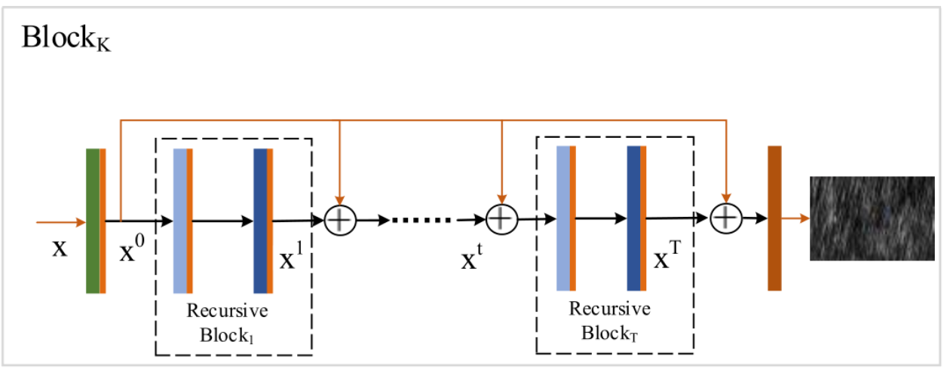
4. Recursive Computation
We adopt two convolutional operation in each recursive unit the output feature map of first feature extraction Conv+LReLU structure is fed into all subsequent outputs of recursive blocks.

Slide 6
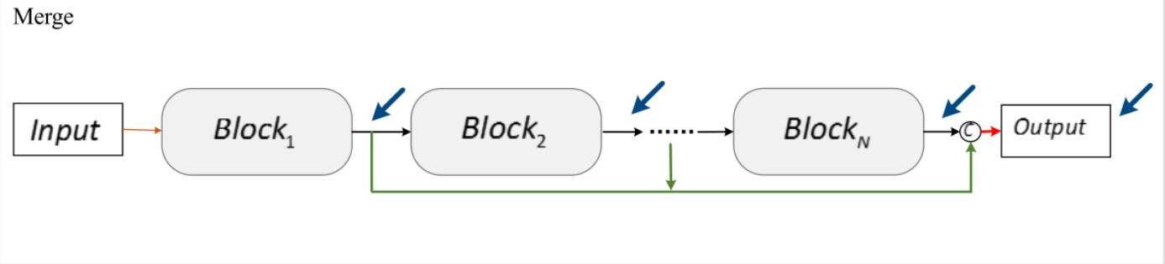
5 Inter-block Ensemble
The final reconstruction is obtained from the fusion of all intermediate reconstructions by a 1×1 convolution

Slide 7
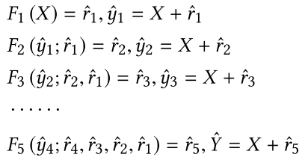
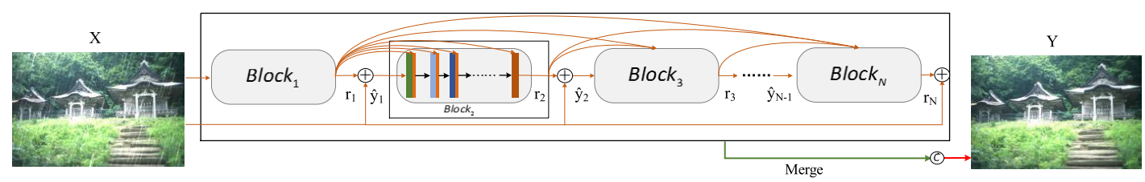
6. The proposed Architecture
Basic network structure:

Slide 8
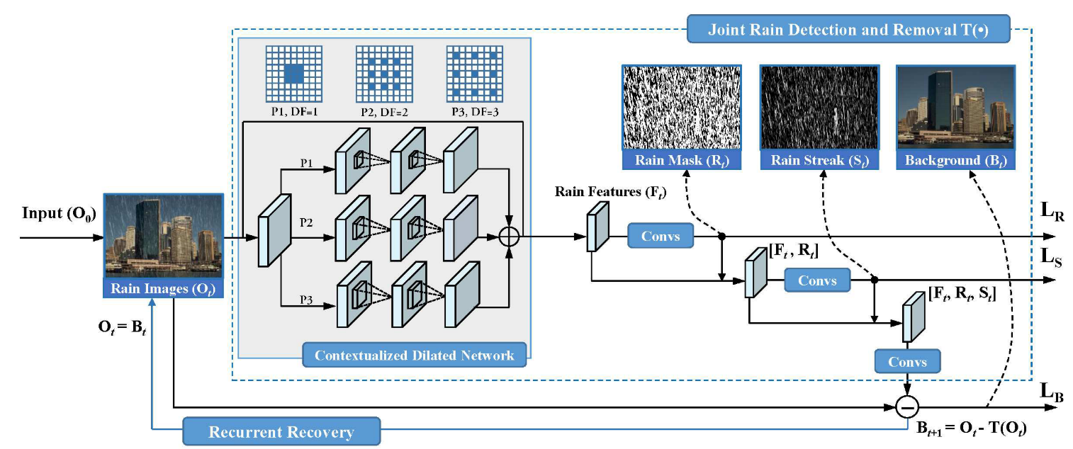

Slide 9
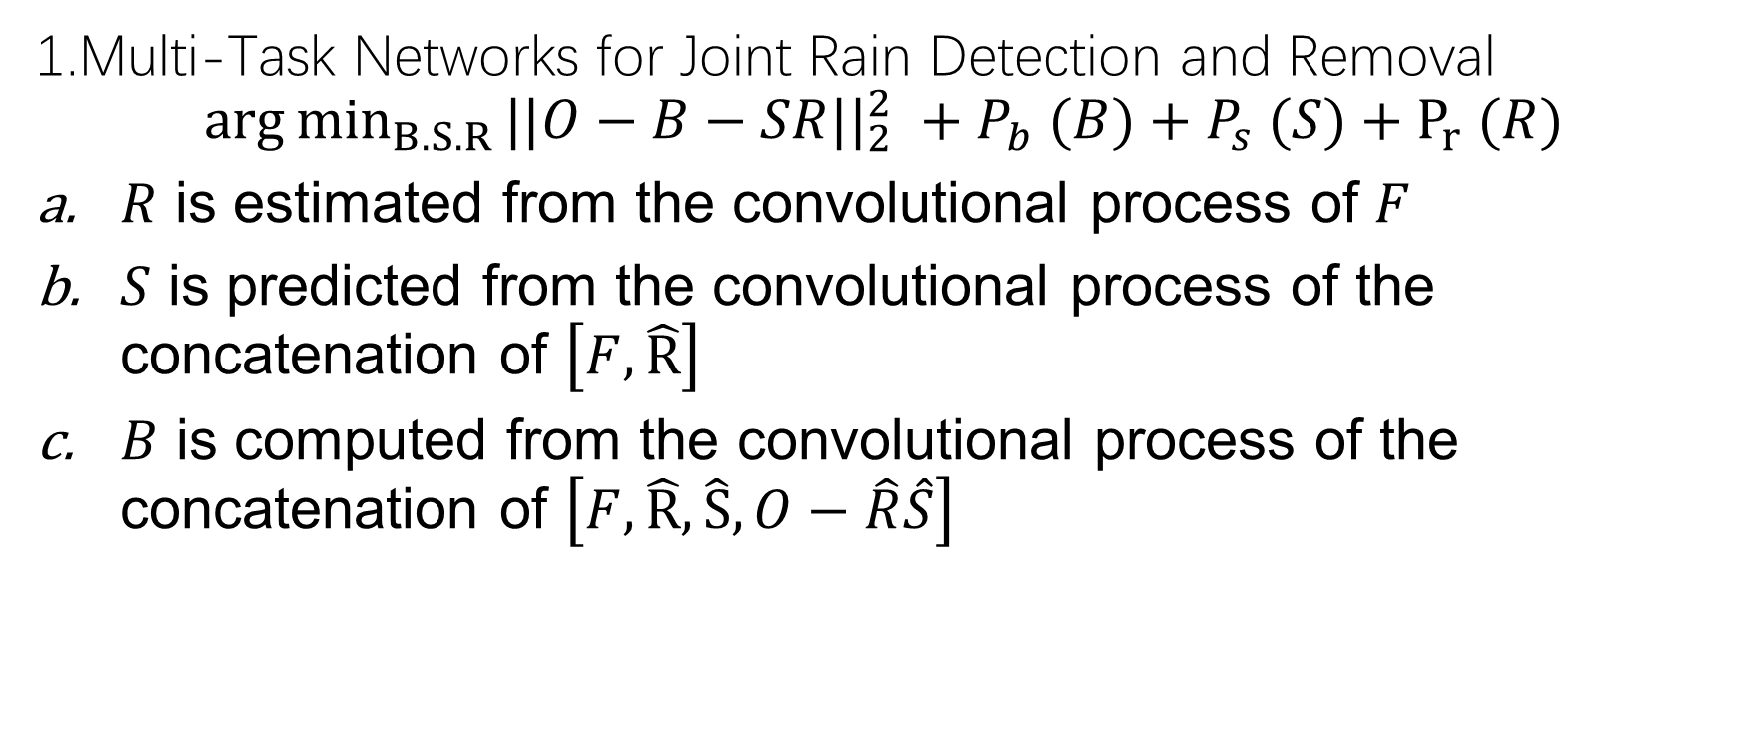
Joint Rain Streak Detection and Removal
1.Multi-Task Networks for Joint Rain Detection and Removal
$${arg⁡min}_{B.S.R}⁡{||O−B−SR||}_{2}^{2} +P_{b} (B)+P_{s} (S)+P_{r⁡} (R)$$
$R$ is estimated from the convolutional process of $F$
$S$ is predicted from the convolutional process of the concatenation of $\left[F, \hat{R}\right]$
$B$ is computed from the convolutional process of the concatenation of $\left[F, \hat{R}, \hat{S},O−\hat{R}\hat{S}\right]$

Slide 10

2. Contextualized Dilated Networks
$Through$ a recurrent structure provides an increasingly larger receptive field for the subsequent layer
in each recurrence, the output features aggregate the representations of the three convolution paths with different dilated factors and receptive fields

Slide 11
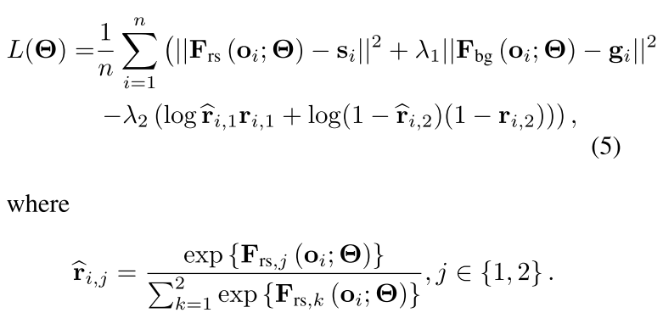
3. Network Training

Slide 12
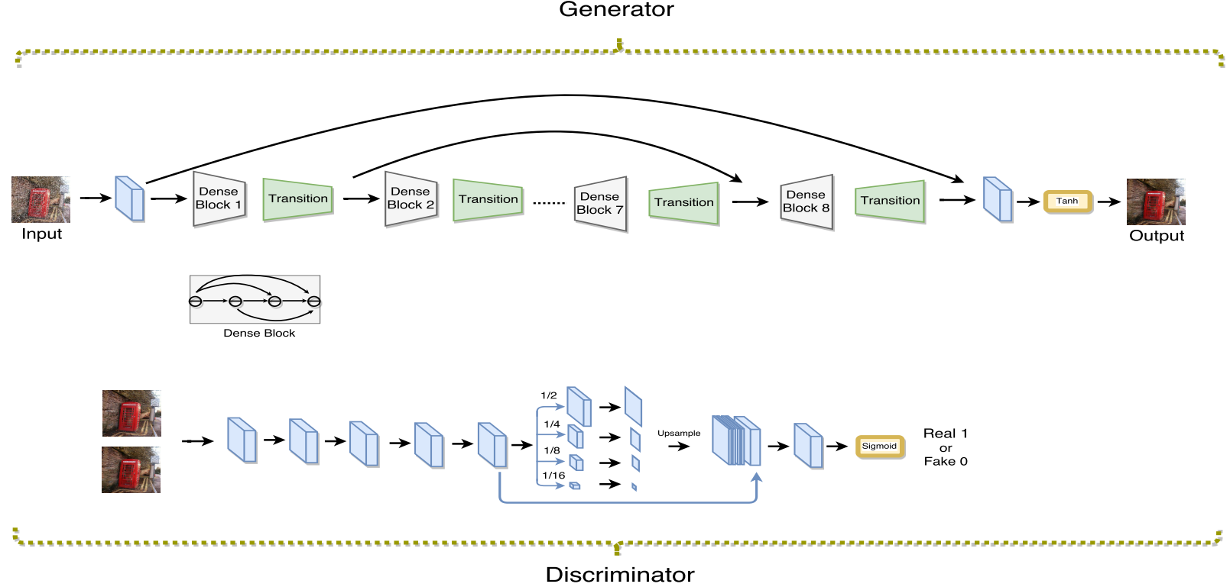
Proposed Method
ID-CGAN：generator, discriminator and perceptual loss function

Slide 13
A.GAN Objective Function
Given an input rainy image x, conditional GAN learns a non-linear function to synthesize the output image y by conditioning on the input image x.
B.Generator with symmetric structure
These dense blocks enable strong gradient flow and result in improved parameter efficiency.
we introduce skip connections across the dense blocks to efficiently leverage features from different levels and guarantee better convergence.
C. Multi-scale Discriminator
a multi-scale pooling module, which pools features at different scales, is stacked at the end of the discriminator.

Slide 14

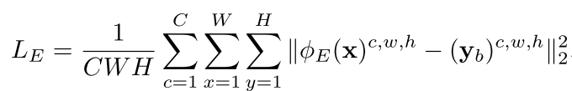
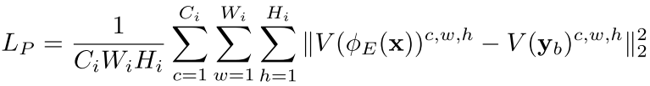
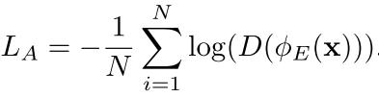
D. Refined Perceptual Loss
we combine pixel-to-pixel Euclidean loss, adversarial loss and perceptual loss together with appropriate weights to form our new refined loss function.

Slide 15
C.data
One picture with 14 different kinds，350 X 14 = 4900.
D.Combining CNN with image enhancement
Use non-linear function to enhance the base layer

Slide 16
Conclusion
We build our model with several derain sub-networks in a cascaded manner.
By propagating negative residuals in shallow blocks to deeper ones, the deeper blocks effectively extract new information ofnegative rain streak residuals to get rain residual in a coarse to fine fashion.
The final reconstruction take all intermediate outputs into account to leverage more informations across blocks which can be viewed as ensemble learning.
Notes:
第二页

